Slide 1
Jet Engine Design
2
3
4
5
1
6
Idealized air-standard
Brayton cycle
diffuser
combustion chamber
turbine
nozzle
compressor
T
4
P=constant
1-2 Isentropic compression in diffuser
2-3 Isentropic compression through compressor
3-4 Constant pressure heat addition
  in combustion chamber
4-5 Isentropic expansion through turbine
5-6 Isentropic expansion in nozzle
6-1 Constant pressure heat rejection
q_{in}
3
5
6
2
q_{out}
1
P=constant
s

Slide 2
Problem Statement
A jet aircraft moves with a velocity of 200 m/s where the air temperature is 20°C and the pressure is 101 kPa. The inlet and exit areas of the turbojet engine of the aircraft are 1 m² and 0.6 m², respectively. It is known that the exit jet nozzle velocity is 1522 m/s (from lab calculation) if the exhaust gases expand to 101 kPa at a temperature of 1,000°C. The mass flow rates of the inlet and exhaust flow are 240 kg/s and 252 kg/s, respectively. As a thermal engineer, your task is to (a) determine if the temperature of the exhaust gases is too high for the turbine blades as they exit from the combustion chamber. (b) Determine the amount of combustion energy necessary to provide the thrust. The maximum tolerable temperature of the blades is 3,000 K. It is known that the pressure ratio of the multi-stage compressor is 8 to 1.
Assumptions and simplifications:
neglect all losses and irreversibilities. All processes are isentropic.
Neglect all kinetic energy components except at the inlet and the nozzle.
Air and fuel mixture behaves as an ideal gas and has the same thermal properties as the air.
All shaft works produced by the turbine are used to drive the compressor.
Air (& mixture) has a constant C_{P}=1 kJ/kg.K, and k=1.4

Slide 3
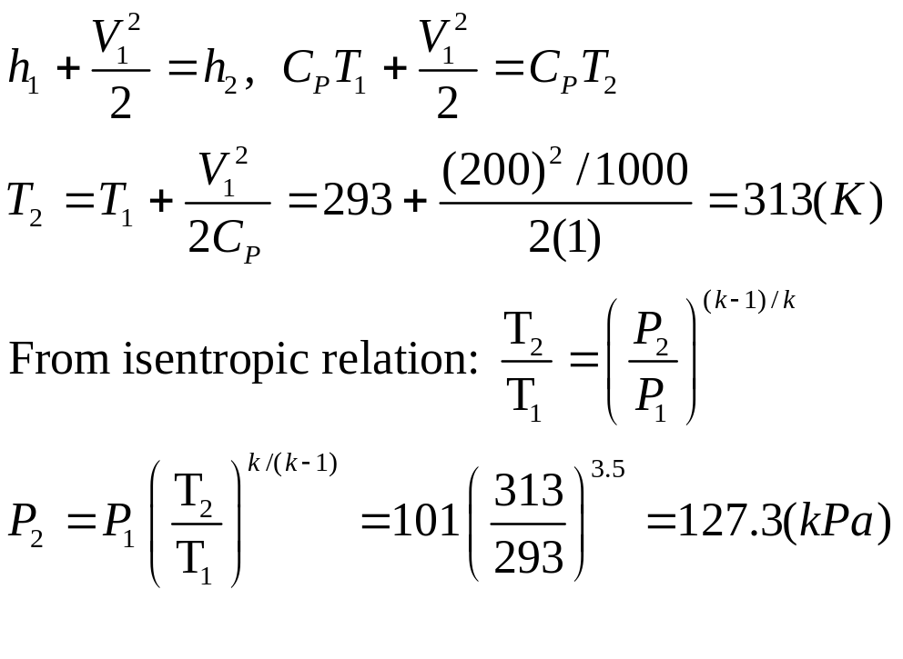
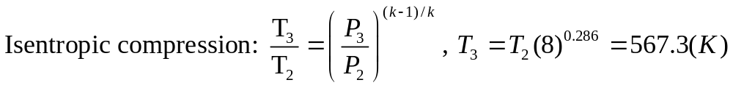
Procedures
Between sections 1 and 2, the incoming flow slows down to increase both the pressure and the temperature before it enters the compressor section. It is an isentropic process.
2
3
4
5
6
1
Across the compressor, the pressure is further increase to eight times of P₂ and this is accompanied by an increase of temperature also. P₃=8P₂=1018.4(kPa)

Slide 4
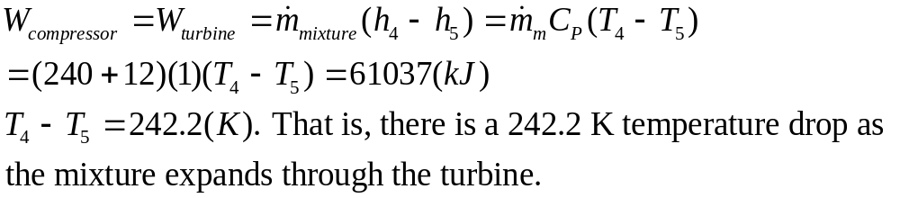
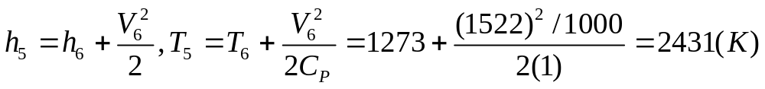
Procedures (cont.)
The shaft work of the compressor is equal to the difference of enthalpy before and after the compressor.
The same amount of shaft work is produced across the turbine section as assumed.
In order to determine the temperature entering the turbine (T₄), we need to find the temperature exiting the turbine (T₅) and it is related to the temperature exiting the nozzle (T₆) as it is expanding in the nozzle through an isentropic process.

Slide 5
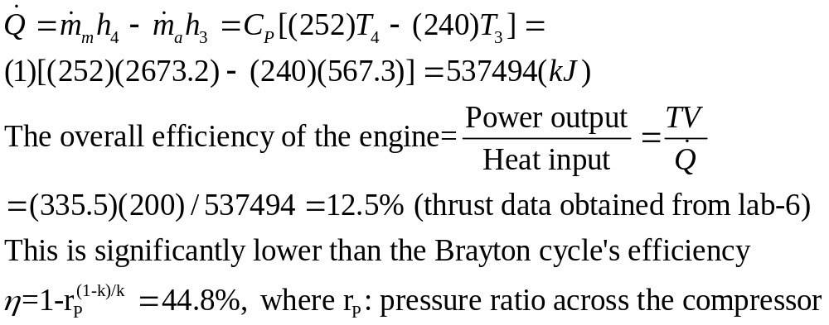
Procedures (cont.)
Therefore, the temperature of the hot gas entering the turbine section will be at a temperature of T₄=T₅+242.2=2673.2(K) and it is below the maximum tolerable temperature of 3,000 K.
The total thermal energy supplied into the engine can be determined as the difference of the energy in and out of the combustion chamber:
Note: I neglect the energy of the fuel by assuming that is small compared to the combustion energy.

Slide 6
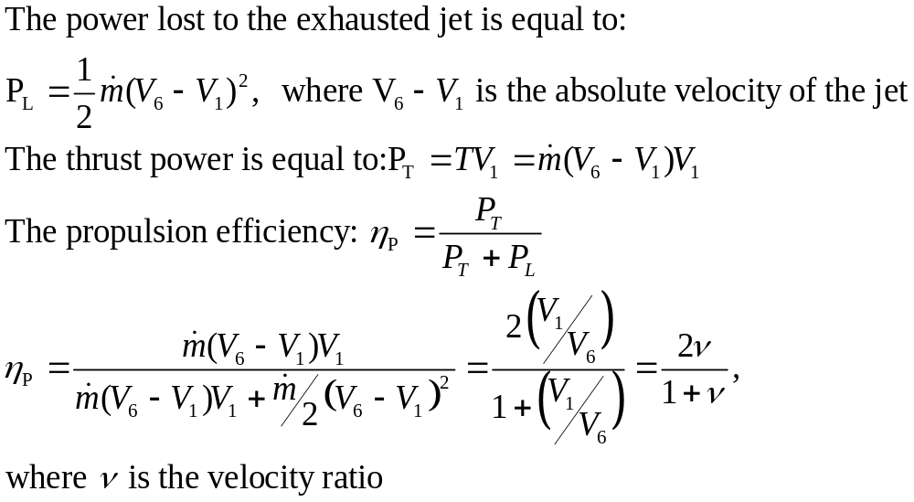
Propulsion Efficiency
Define propulsion efficiency as the ratio of the thrust power (P_{T}) to the rate of production of propellant kinetic energy (P_{T}+P_{L}). Where the total kinetic energy is the sum of the thrust power and the power that is lost to the exhaust jet (P_{L}).

Slide 7
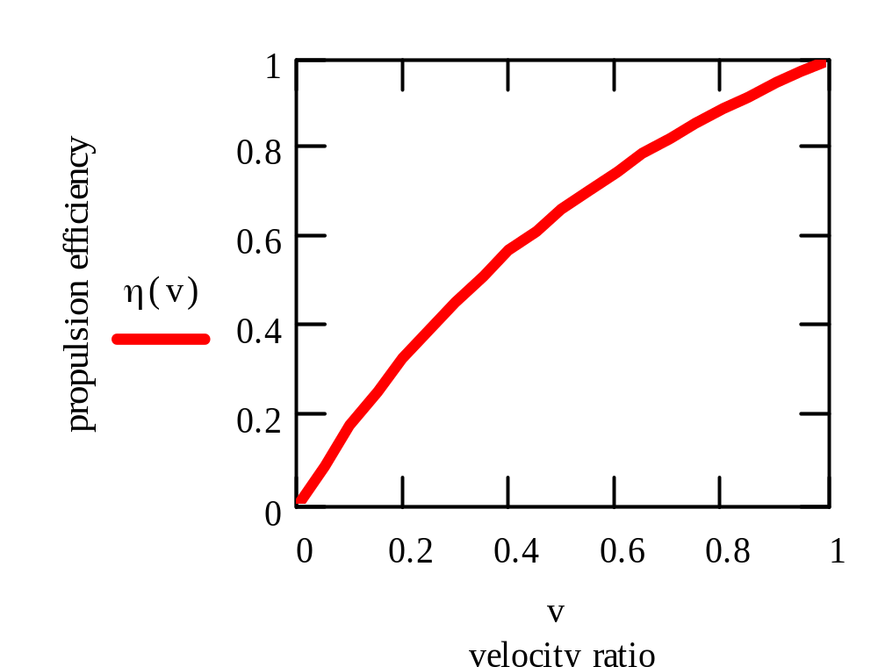
Propulsion Efficiency & Turbofan
The propulsion efficiency increases as the velocity ratio is increased.
It reaches a maximum at v=1 and η=1. No lost kinetic energy but also no thrust since V₁=V₆.
It also suggests that in order to increase the propulsion efficiency one would like to operate at relatively low jet nozzle velocity.
In order to avoid the loss of thrust, the mass flow rate has to be increased.
Consequently, turbofan engine is a more efficiency engine as compared to the turbojet engine since the fan can induce large amount of the propellant into the engine and can operate at a relatively low jet exhaust speed.

Slide 8
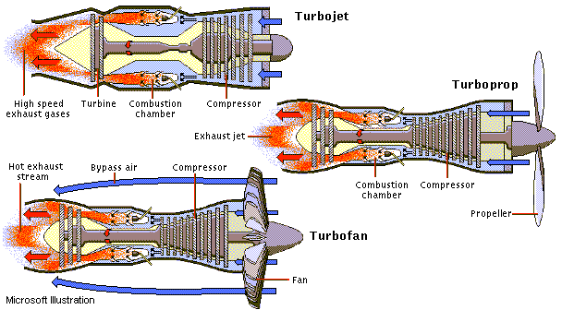
Gas Power Cycle - Jet Propulsion Technology, A Case Study
Pratt_Whitney Turbojet Engine
Pratt-Whitney Turbofan Engine

